Slide 1
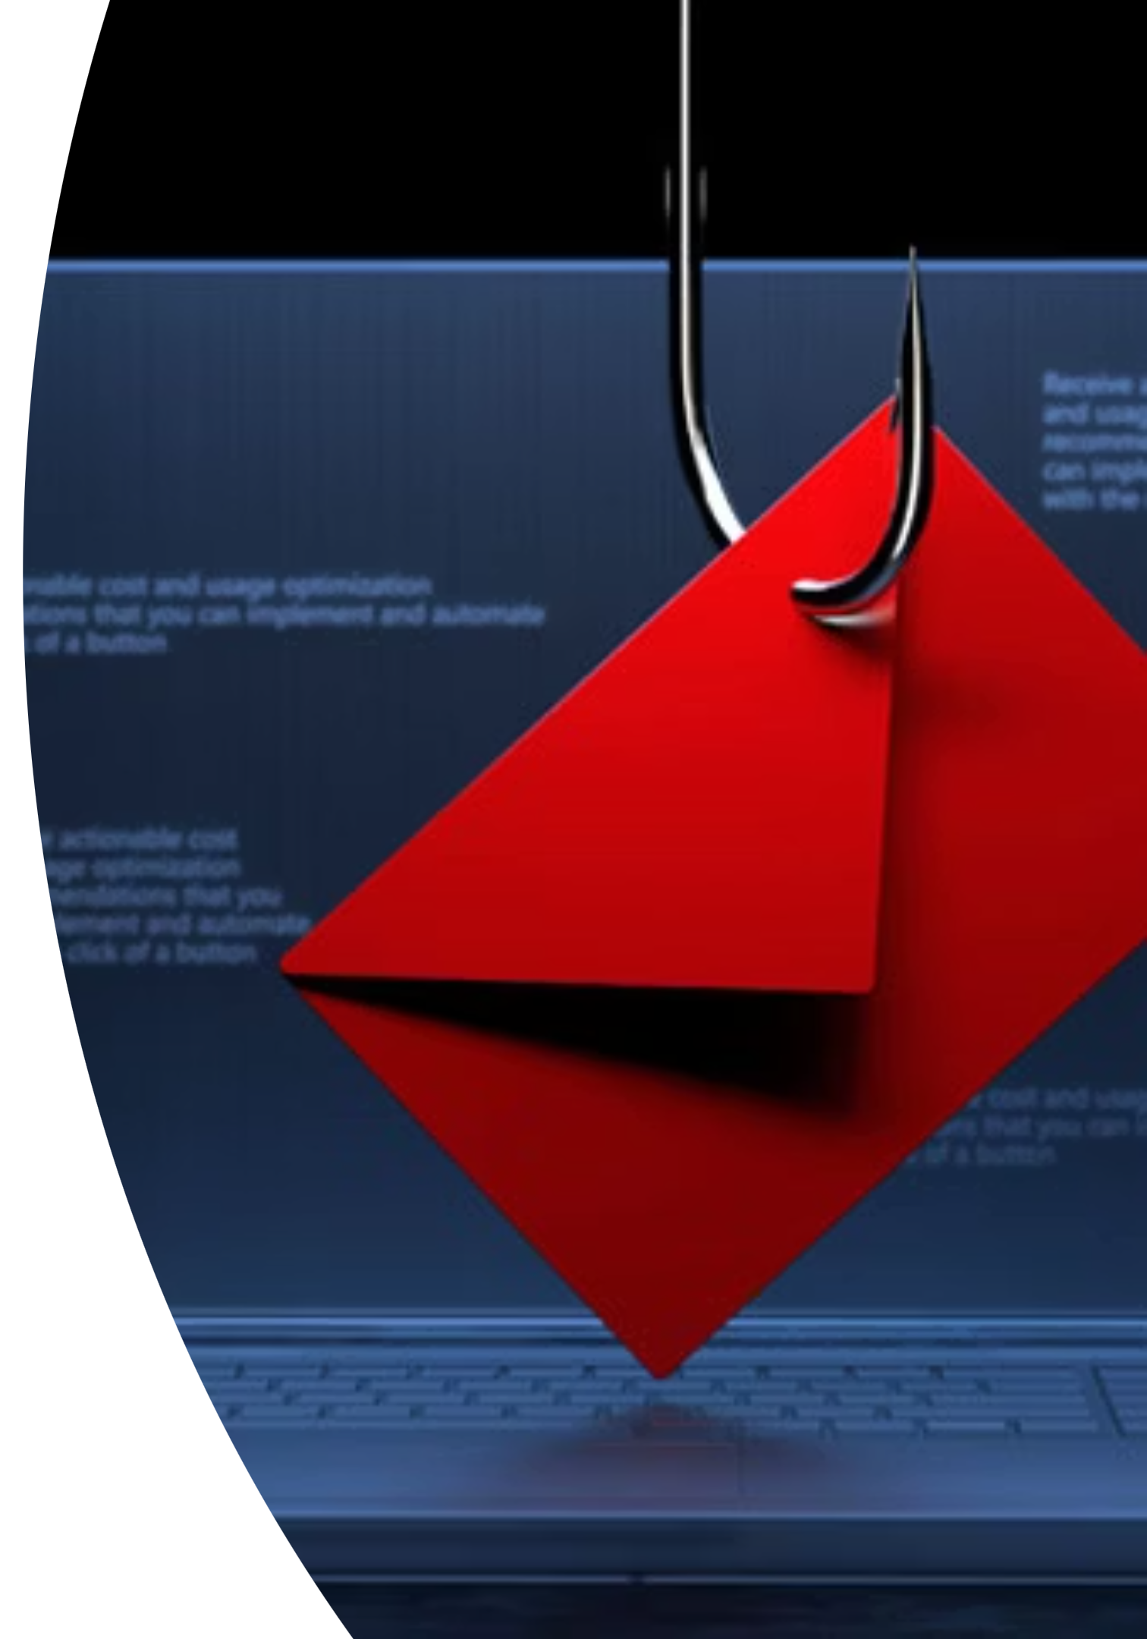

Phishing Awareness Training
Securing Our Digital Front Door
Organization: Code Alpha
Presenter: Ahmad Sameer
LinkedIn | GitHub

Slide 2
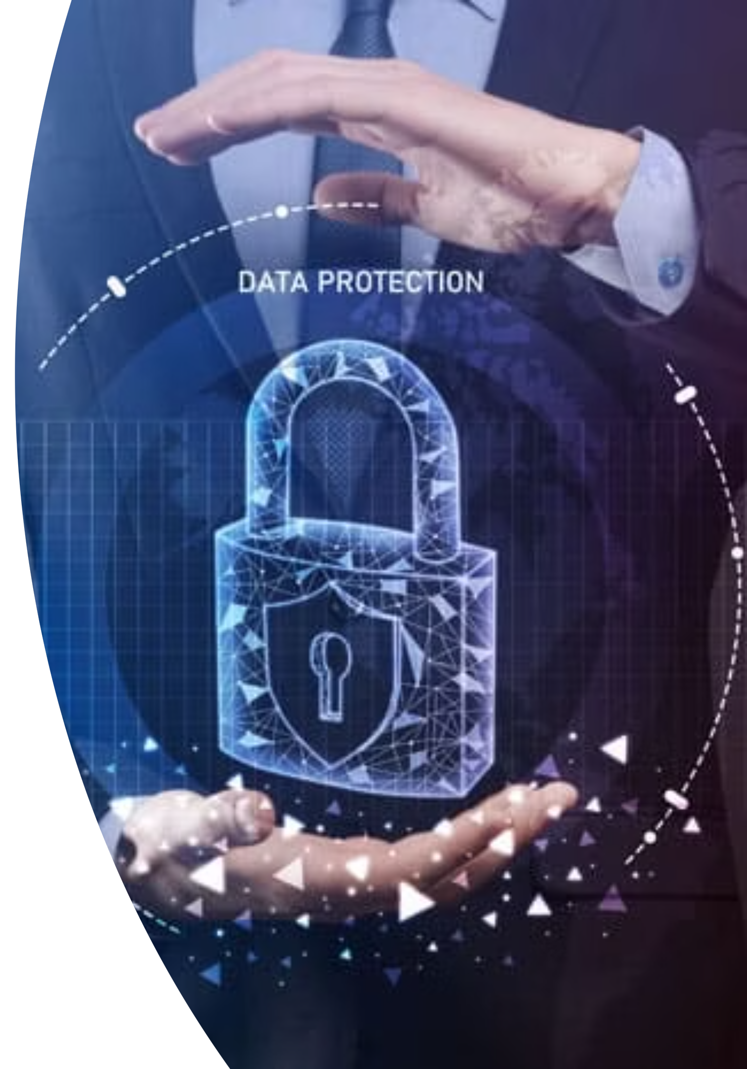
Protect Yourself and Your Organization
Welcome to this essential training module designed to equip you with the knowledge and tools to effectively identify, avoid, and report phishing attacks. In the modern digital landscape, awareness is your first and strongest defense against evolving cyber threats.
Understanding the mechanisms of phishing—and the social engineering tactics behind them—is crucial for safeguarding sensitive personal and organizational data.

Slide 3

Why Phishing Awareness Matter's
The Scale of the Problem: Explain that phishing is the most common form of cyberattack. Over 90% of all cyberattacks begin with a phishing email. It's not a question of if we will be targeted, but when.
Real-World Consequences:
Financial Loss: Direct theft of funds, fraudulent transactions, and costs associated with incident response.
Data Breaches: Loss of sensitive company data (intellectual property, customer information, financial records) and personal data (PII).
Reputational Damage: Loss of customer and partner trust, which can be difficult to recover from.
Operational Disruption: Business operations can be shut down or severely hampered during and after an attack.

Slide 4
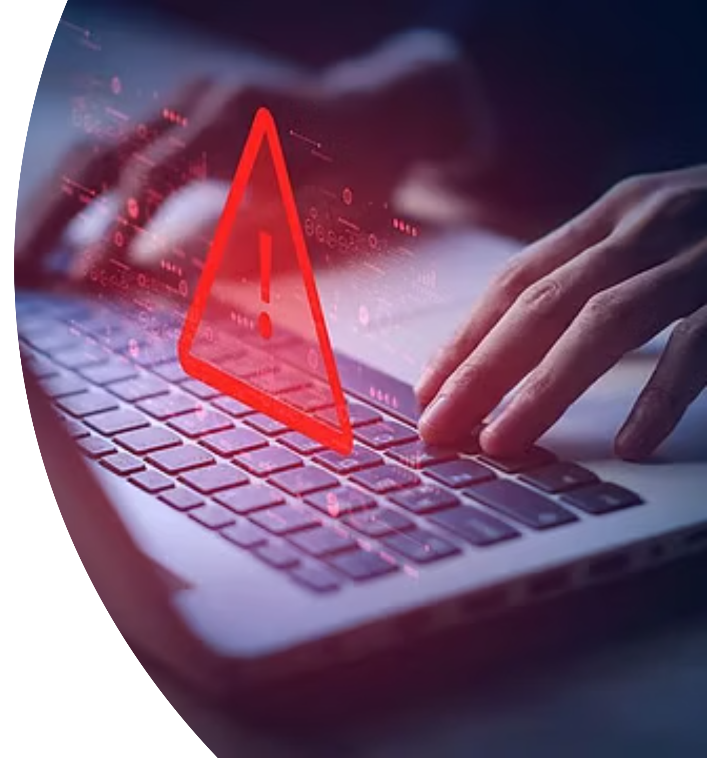
CHAPTER 1
THE THREAT / Understanding of Phishing

Slide 5
What is Phishing?
Phishing is a type of social engineering attack often used to steal user data, including login credentials and credit card numbers. It occurs when an attacker, masquerading as a trusted entity, dupes a victim into opening an email, instant message, or text message.
Deceptive Communication
Top Cybercrime
Cybercriminals use deceptive emails, texts, or websites to trick individuals into revealing sensitive information like passwords, financial data, or proprietary company secrets.
Phishing remains the single most common type of cyber attack. In 2024, it accounted for the largest percentage of complaints reported to the FBI's Internet Crime Complaint Center (IC3), highlighting its pervasive and dangerous nature.
Impersonation Tactics
Exploiting Human Vulnerability: The Psychological Dimension
Attacks frequently rely on impersonating trusted organizations (like banks, tech companies, or government agencies) or internal colleagues/executives to lower the victim's guard and appear legitimate.
Research has identified three dominant psychological traits exploited in phishing attacks: a sense of urgency, fear through threatening, and enticement with desire.

Slide 6
How Phishing Works
The Attack Lifecycle
1
Lure: The attacker sends a deceptive message, often with a sense of urgency, fear, or a compelling offer.
2
Hook: The message contains a malicious link or an attachment. The user is "hooked" when they click the link or open the file.
3
Exploit: Once the link is clicked, it leads to a fake website where the user is asked to enter credentials, or the attachment installs malware on their device. The exploit phase is when the attacker gains access.

Slide 7
Types of Phishing Attacks
Not All Phish Are Alike
1
2
3
Email Phishing: The most common type. Broad, non-targeted attacks sent to millions of users, often from a fake bank or social media site.
Spear Phishing: Highly targeted. The attacker researches the victim (or organization) and creates a personalized message. It often impersonates a known contact.
Whaling: A type of spear phishing targeting senior executives (e.g., CEO, CFO). The goal is often to manipulate them into authorizing large financial transfers.
4
5
6
Smishing (SMS Phishing): Uses text messages to trick you. Messages often contain a link and might pretend to be a delivery service or a bank.
Vishing (Voice Phishing): Uses phone calls. The caller pretends to be from a legitimate company (e.g., tech support, your bank) to get you to reveal information.
Clone Phishing: The attacker copies a legitimate, previously sent email and replaces the links or attachments with malicious ones. They then send the cloned email from a spoofed address.

Slide 8
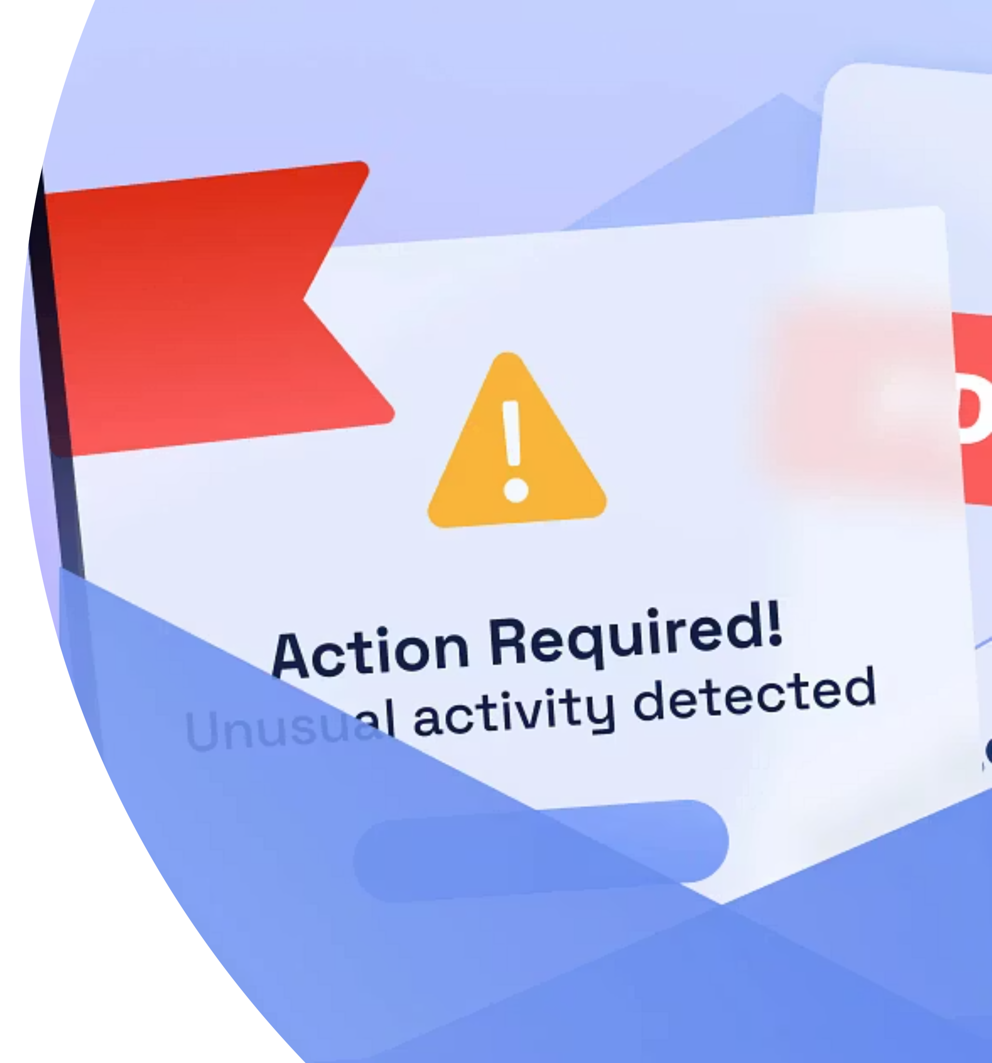
CHAPTER 2
RECOGNITION

Slide 9





Recognizing Phishing Emails: Key Red Flags
The key to preventing a successful phishing attack is meticulous scrutiny of every unexpected or suspicious communication. Several common signs can help you distinguish a legitimate message from a malicious one.
Sense of Urgency/Threat
Generic Greetings
Sender Mismatch
Watch for language that demands immediate action, often paired with threats, such as "Your account will be locked," "Final Notice," or "Immediate payment required." This rushes your decision-making.
A legitimate organization that manages your account should know your name. Phishing emails often use impersonal salutations like "Dear Customer," "Sir/Madam," or "Valued User."
Carefully check the sender's full email address. Look for subtle misspellings in the domain name (e.g., micros0ft.com instead of microsoft.com) or a domain that doesn't match the claimed company.
Suspicious Links
Unexpected Attachments
Always hover your mouse cursor over any hyperlink (without clicking) to see the actual destination URL that appears in the corner of your browser or email client. If the previewed URL doesn't match the claimed source, it's a huge red flag.
Be wary of unsolicited attachments, especially common file types like ZIP, .EXE, or even PDFs or Microsoft Office documents that require macros to view. Never open attachments from senders you don't recognize or weren't expecting.

Slide 10
RECOGNITION / FAKE WEBSITES
Spotting Fake Websites: Beyond the Padlock
Phishing often relies on directing victims to highly convincing replica websites designed solely to harvest credentials. Knowing what to look for can save your data.
1
Verify the URL in the Address Bar
2
HTTPS and Security Certificates
Look closely at the domain name. Phishers use common tricks like adding hyphens, substituting letters (e.g., appl3.com), or adding subdomains (e.g., bank.login-secure.com).
While the 'HTTPS' (padlock icon) indicates encrypted traffic, it is no longer a guarantee of safety. Free SSL certificates mean many phishing sites now use HTTPS. Look for Extended Validation (EV) certificates for financial sites, which display the company name.
3
Visual Inconsistencies
4
Safe Navigation Practices
If a website looks unprofessional, has poor grammar, or subtle color/logo differences compared to the official site, exit immediately. Attackers are good, but rarely perfect, at replication.
Whenever possible, avoid accessing sensitive sites via links in emails. Instead, use official browser bookmarks, or manually type the URL into your browser's address bar.

Slide 11
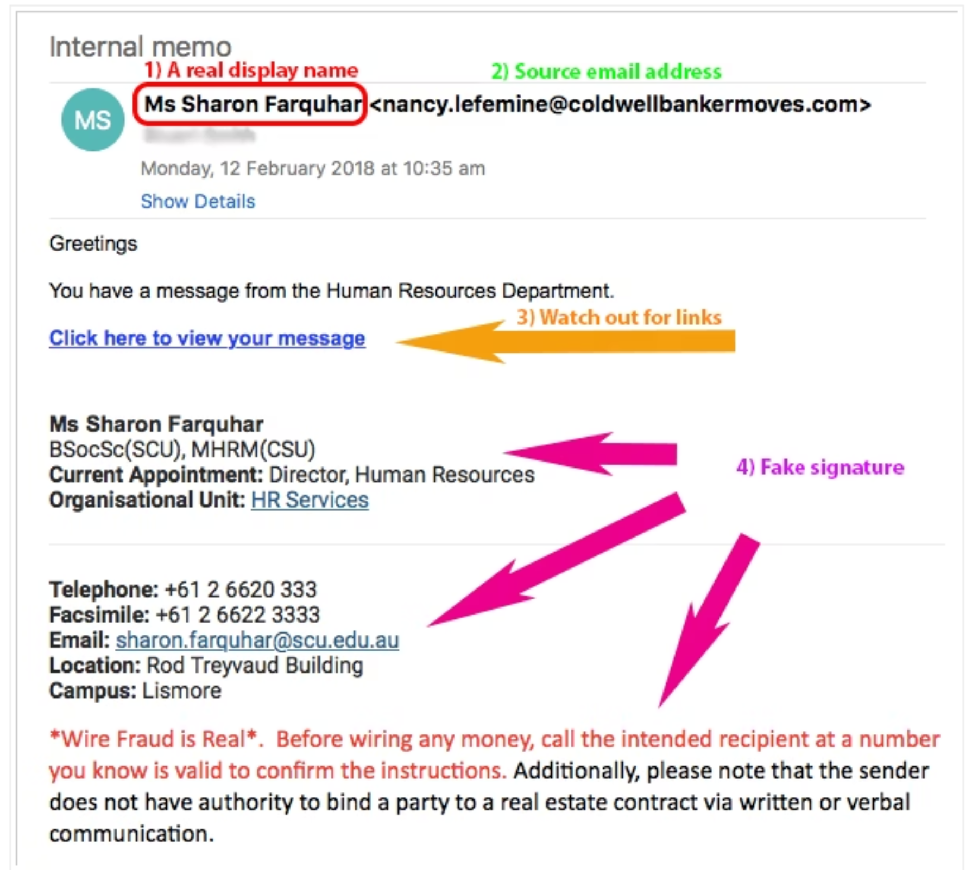

Spotting Fake Email
The Danger of Credential Entry
Never enter login credentials (username and password) on a website you were directed to via an unexpected email link. If you suspect you've entered credentials on a fake site, change your password immediately on the legitimate platform.

Slide 12
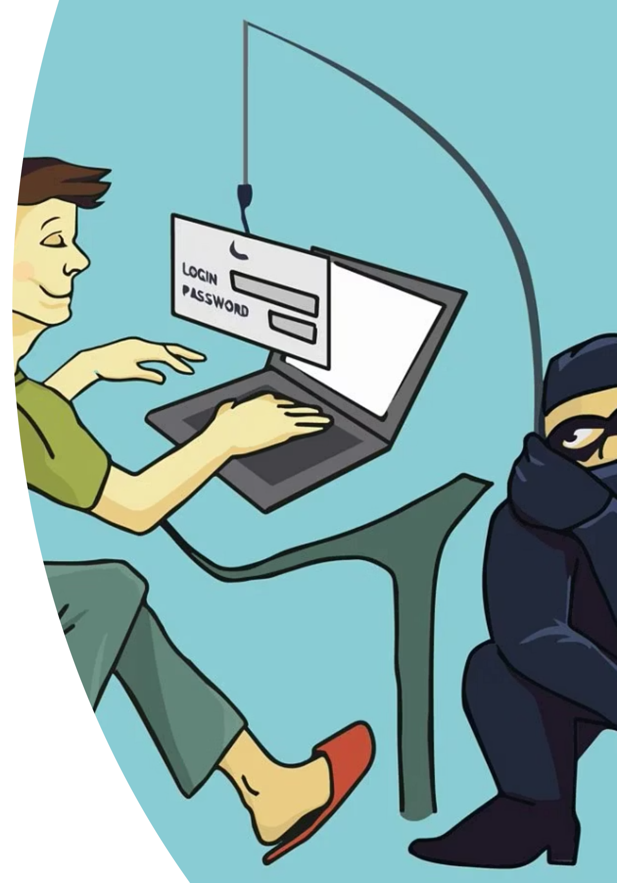
CHAPTER 3
Social Engineering

Slide 13








TACTICS / MANIPULATION
Social Engineering Tactics
Phishing attacks are successful because they exploit human psychology. Social engineering is the act of manipulating people into performing actions or divulging confidential information.
Impersonation (Pretexting)
Urgency and Fear
Attackers create a believable 'pretext' by impersonating trusted roles, such as an IT administrator, a senior executive (CEO fraud), or a customer service representative. This exploits our natural tendency to obey authority.
Creating panic (e.g., "Your account is compromised!") or setting tight deadlines pushes the victim to bypass standard security checks and act impulsively, often clicking a malicious link without thinking.
Multi-Channel Attacks
Modern phishing extends beyond email:
Leveraging Personal Data
Vishing (Voice Phishing): Using automated or live phone calls.
Attackers use information scraped from social media or acquired through data breaches to make their messages highly personalized and believable. Referencing a recent purchase or colleague’s name makes the phish seem more authentic.
Smishing (SMS Phishing): Using malicious text messages.
Spear Phishing: Highly targeted attacks aimed at specific individuals or departments.

Slide 14
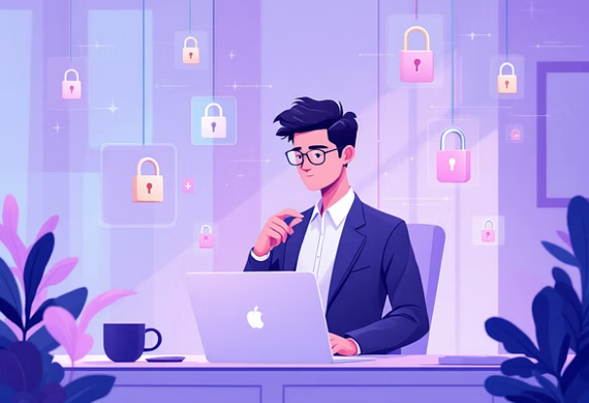
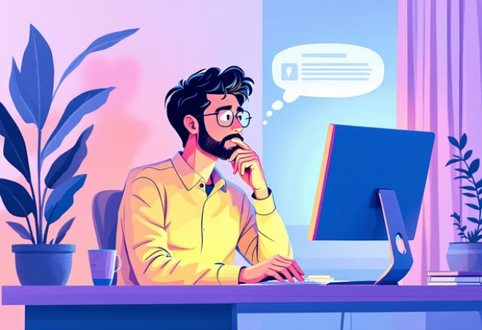
CHAPTER 3 / DEFENSE STRATEGIES
Best Practices to Avoid Phishing
Proactive security hygiene is essential. Implement these protective measures to dramatically reduce your risk of becoming a phishing victim.
Verify Requests Independently
If you receive an unexpected request (especially from an alleged boss or vendor) asking for funds or sensitive data, always verify it through a separate communication channel (e.g., a phone call to a known number).
Avoid Clicks & Attachments
Adopt a "Default Deny" mindset. Never click links or open attachments from unknown sources. Be suspicious of emails that seem even slightly off—trust your gut.
Enable Multi-Factor Authentication (MFA)
MFA is a critical defense. Even if phishers steal your password, they cannot access your account without the second verification code (e.g., from an authenticator app or text message).
Maintain Current Software
Ensure your operating systems, browsers, and antivirus software are set to update automatically. These updates patch security vulnerabilities that attackers often exploit.
Report Suspicious Activity
Immediately forward or report any suspicious emails to your organization's IT or Security team. Your timely report helps protect not just you, but everyone in the organization.

Slide 15

Company Policy & Reporting
If You See Something, Say Something
Reporting:
Clearly state the process for reporting phishing attempts.
"Use the 'Report Phishing' button in Outlook/Gmail."
"Forward the suspicious email to phishing@yourcompany.com."
"Contact the IT Help Desk at [phone number]."
Why Reporting Matters: Reporting helps protect the entire organization. The IT Security team can block the malicious sender, scan for similar threats, and alert other employees.

Slide 16

CHAPTER 4
Real-World Case Studies

Slide 17
CASE STUDY / PHISHING IN ACTION
Real-World Example: The "Account Suspension" Scam
This common scenario illustrates the high-stakes risk of financial phishing designed to exploit fear and urgency.
1. The Lure
2. The Call to Action
The victim receives an official-looking email claiming their bank or payment account (e.g., PayPal, Venmo) has been temporarily suspended due to "suspicious activity." The email contains official logos and branding.
The email urgently instructs the victim to click a provided link to a landing page to "verify identity" or "confirm recent transactions" and reactivate the account. This link leads to a fake login page.
3. Credential Harvesting
4. The Payoff
Fearing loss of access to their money, the victim enters their username and password on the convincing fake website. These credentials are instantly captured by the attackers.
The attackers use the stolen credentials to log into the legitimate bank website, where they can initiate fraudulent transfers, change contact information, or drain the account's funds.
Lesson Learned: Legitimate financial institutions will never ask you to click a link in an email to verify or re-enter sensitive login details. If your account is truly suspended, they would typically instruct you to call a verified number or log in through their official app/website.

Slide 18
INTERACTIVE TRAINING
Interactive Quiz: Spot the Phish!
Test your newly acquired knowledge. Read the options carefully and identify the exception—the trait that is NOT typically a phishing red flag.
A) Urgent Language
B) Personalized Greeting
Phrases like "Action Required Within 2 Hours" or "Account Deletion Pending."
A greeting that uses your correct, full name (e.g., "Dear John Smith").
C) Suspicious Link URL
D) Unexpected Attachment
A hidden link where the preview URL shows an unfamiliar or misspelled domain.
An unsolicited ZIP file or a strange invoice from an unknown sender.
Take a moment to decide which characteristic is most often found in legitimate, non-phishing communications. The correct answer is on the next card.

Slide 19
Which is NOT a common red flag in a phishing email?
A) Generic greeting
B) Urgent language
C) Perfect grammar
D) Unexpected attachment.
What does the 'S' in HTTPS stand for?
A) Spam
B) Secure
C) Sender
D) Server
What is the best way to verify a suspicious request from a superior?
A) Reply to the email
B) Do as they say
C) Contact them on a known, trusted number
D) Ignore the request

Slide 20



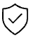
QUIZ REVIEW
Quiz Answer & Key Takeaway
Correct Answer: B) Personalized Greeting
Legitimate companies and services that manage your account typically personalize their communication by addressing you by name, especially for official business. Phishing attempts often use generic greetings (Dear Customer) because they broadcast the same email to thousands of potential victims without knowing their individual names.
Pause and Analyze
The most crucial step is to create a moment of reflection. Never click immediately. Stop and systematically check the sender, the links, and the tone of the message.
2. Correct Answer: (c) Perfect grammar
Verify Independently
Phishing emails often contain poor grammar, typos, or awkward phrasing — so perfect grammar is not a red flag. In fact, it might make a phishing email seem more legitimate.
If an email from your bank or IT department seems urgent, close the email and use a trusted channel (e.g., log into the official website directly or call their known number) to verify the message's authenticity.
3. Correct Answer: (b) Secure
HTTPS means “Hypertext Transfer Protocol Secure.” It indicates that the data between your browser and the website is encrypted — but remember, a secure site can still host a phishing scam if the attacker uses HTTPS on a fake domain
When in Doubt, Report
Never hesitate to report suspicious emails. Your vigilance acts as an early warning system for the entire organization, helping prevent a wider security incident.
4. Correct Answer: (c) Contact them on a known, trusted number
Always verify requests (especially involving money or credentials) using independent communication channels — like calling or messaging the person directly using contact info you already have.!

Slide 21




Summary: Key Takeaways
Remember These Four Things
Think Before You Click: Pause and analyze the message. Don't let urgency or curiosity override your caution.
Verify, Don't Trust: Independently verify any suspicious requests, especially those involving sensitive information or money.
1
2
Report Everything: Use the internal reporting process for every suspicious email, even if you are unsure.
Check the Details: Scrutinize the sender, the links, and the language for any inconsistencies or red flags.
4
3

Slide 22
FINAL THOUGHTS
Stay Vigilant, Stay Safe
Phishing techniques are constantly evolving, becoming more sophisticated and difficult to detect, often utilizing advanced tactics like AI-generated content (deepfakes) and highly personalized information (whaling). Continuous vigilance is non-negotiable.
Awareness is the Best Defense
Protect the Organization
Build a Culture of Security
Regular training and continuous education are vital. Treat every unsolicited email, text, or phone call with a degree of skepticism.
By protecting your own credentials and devices, you are protecting the integrity and operational continuity of the entire company.
Share the knowledge you’ve gained today with colleagues. Encourage them to report suspicious activity and maintain strong security practices.
Thank You

Slide 23
Contact Information:
Presenter Name: AHMAD SAMEER
job Title: Cybersecurity Analyst
Email Address: ahmadsameer0990@gmail.com
LinkedIn | GitHub
Organization: Code Alpha

Slide 24
References and Resources
Reference: U.S. Cybersecurity and Infrastructure Security Agency. (2023). Phishing Guidance: Stopping the Attack Cycle at Phase One. Retrieved from https://www.cisa.gov/sites/default/files/2023-10/Phishing%20Guidance%20-%20Stopping%20the%20Attack%20Cycle%20at%20Phase%20One_508c.pdf
NCSC.GOV.UK. (n.d.). Phishing attacks: defending your organisation. Retrieved from https://www.ncsc.gov.uk/guidance/phishing
Defendify. (n.d.). The Modern Phishing Awareness Training Guide for Employees. Retrieved from https://www.defendify.com/blog/phishing-awareness-training-for-employees/
Phishing.org. (n.d.). Phishing Resources. Retrieved from https://www.phishing.org/phishing-resources
Secureframe. (2025). 60+ Phishing Attack Statistics: The Facts You Need To Know for 2026. Retrieved from https://secureframe.com/blog/phishing-attack-statistics
Keepnet Labs. (2025). 2025 Phishing Statistics: (Updated August 2025). Retrieved from https://keepnetlabs.com/blog/top-phishing-statistics-and-trends-you-must-know
Hoxhunt. (2025). Phishing Trends Report (Updated for 2025). Retrieved from https://hoxhunt.com/guide/phishing-trends-report
IJRASET. (n.d.). Understanding Human Vulnerabilities: A Study on Social Engineering Techniques in Cybersecurity. Retrieved from https://www.ijraset.com/research-paper/social-engineering-techniques-in-cybersecurity

